Slide 1

Advanced Certification Program in Software Testing in collaboration with IBM
Name : Saranya Rajendran
Trainer : Vishakha Desai

Slide 2




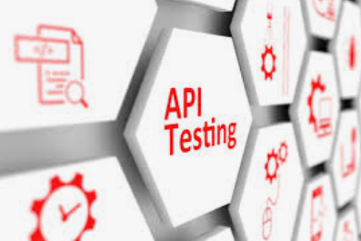
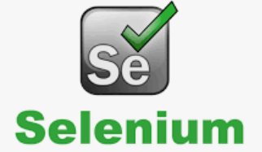




Advanced Certification Program in Software Testing in collaboration with IBM

Slide 3
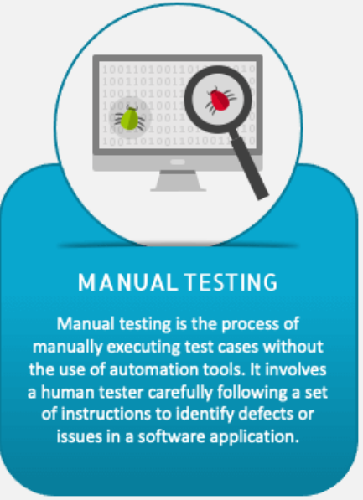
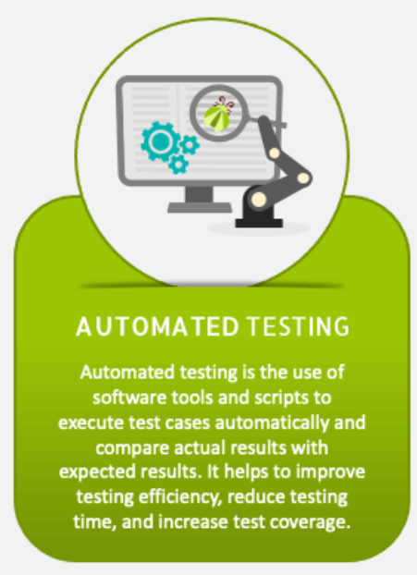
PROJECTS
Manual Project
Automation Project
Project Name:
Blood Bank Today &
JunkyBooks
Project Link:
https://github.com/saranyarinu/EduBridge_ManualProject
Project Name:
Swag Labs /
saucedemo
Project Link:
https://github.com/saranyarinu/EduBridge_AutomationProject

Slide 4
MANUAL PROJECT: Blood Bank Today https://bloodbanktoday.com/
Scope Of Project:
BloodBankToday is a comprehensive platform facilitating blood donation through user registration, appointment scheduling, emergency requests, and community engagement, while ensuring privacy, security, and scalability.
Types Of Testing:
Test Summary Report:
Smoke Testing
Unit Testing
Integration Testing
System Testing
UI Testing
Performance Testing
Cross-browser Testing
Total No. of Modules | 15
No. of Modules tested | 12
Total No. of Scenarios / Executed | 12/12
No. of Test Cases / Executed | 82/82
Defect Summary Report:
Severity | No. of Defects | Total No. of Defects
Major | 16 | 31
Medium | 8
Low | 7

Slide 5
MANUAL PROJECT: JunkyBooks https://www.junkybooks.com/login.php
Scope Of Project:
Junky Books is a product with the vision to provide an extensive library of books in digital format for free to every one around the world.
Smoke Testing
Unit Testing
Integration Testing
System Testing
UI Testing
Performance Testing
Cross-browser Testing
Types Of Testing:
Test Summary Report:
Total No. of Modules | 12
No. of Modules tested | 6
Total No. of Scenarios / Executed | 6/6
No. of Test Cases / Executed | 30/30
Defect Summary Report:
Severity | No. of Defects | Total No. of Defects
Major | 3 | 6
Medium | 1
Low | 2

Slide 6
AUTOMATION PROJECT: Swag Labs https://www.saucedemo.com/
Scope Of Project: Swag Labs demo application showcases a simplified version of the main application, featuring a limited selection of products for browsing, adding to cart, and checkout, offering users a glimpse into the platform's functionality and user experience.
DDT(Data Driven Testing)
KDT
(Keyword Driven Testing)
Hybrid
BDD (Behaviour Driven Development)
TestNG
Automation Frameworks Used:
Responsibilities:
Analysis of requirements, designing test scripts using Maven with TestNG.
Types Of Testing Performed:
Cross Browser Testing
Parallel Testing
Smoke Testing
URL Verification
Page Verification
Multiple Test Cases
Main functionality of the application

Slide 7
Feeling gratitude and not expressing it is like wrapping a present and not giving it.
H
N
O
A
K
Y
U
T

